Slide 1

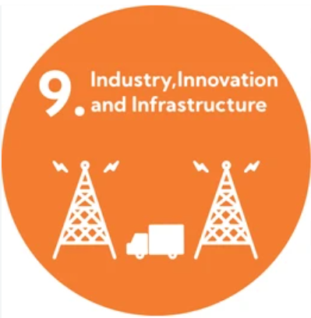


Thermal Pulse
Vel Tech Rangarajan Dr. Sagunthala R&D Institute of Science and Technology
Presented by
Team Heat Blast
NAME: L.Tejani(vtu28866)
NAME: A.Siva Shankar(vtu28853)
NAME: M.V.Tejaswini(vtu30488)

Slide 2
Problem Statement:
Bridges are essential components of transportation infrastructure, connecting cities, communities, and businesses. However, aging structures, environmental exposure, heavy traffic, and limited maintenance resources can contribute to bridge deterioration over time. Traditional inspection methods often require significant time, manpower, and physical access, making continuous monitoring and early identification of potential defects challenging.
Furthermore, inspection data, maintenance records, and repair updates may be managed separately, making it difficult to prioritize inspections and track repair outcomes efficiently. These challenges can delay the identification of infrastructure concerns and increase the complexity of maintenance planning.
ThermalPulse aims to address these challenges through an AI-assisted bridge-monitoring platform that combines satellite-based thermal observations, geospatial analysis, and ground-level image assessment to identify potential concerns for further inspection. The platform provides a centralized dashboard for monitoring bridge observations, prioritizing inspections, managing maintenance activities, and recording post-repair verification. It also includes a simulated autonomous repair vehicle to demonstrate a potential future approach to infrastructure maintenance.
The goal is to support proactive infrastructure management, improve inspection efficiency, and contribute to safer, more reliable, and sustainable transportation infrastructure.

Slide 3
Problem Evidence/Research:
🌉 1. Bridge Infrastructure Challenges Bridges are essential for transportation, connecting people, businesses, and communities. Aging structures, environmental exposure, and heavy traffic can contribute to deterioration, making regular inspection and maintenance important.
🛰️ 2. Satellite-Based Thermal Monitoring Satellite missions such as Landsat provide surface-temperature data that can support environmental monitoring. ThermalPulse aims to analyze unusual temperature patterns around bridges and flag locations for further investigation.
🤖 3. AI-Powered Defect Assessment AI-based image analysis can help identify visible defects in ground-level bridge photographs, supporting inspection teams in prioritizing areas that require professional assessment.
📊 4. Data-Driven Maintenance Planning Combining bridge observations, inspection images, and maintenance records in a centralized dashboard can help authorities organize inspections, monitor repair progress, and maintain traceable records.
🌍 5. Sustainable Development Goals ThermalPulse primarily supports SDG 9 — Industry, Innovation and Infrastructure, with connections to SDG 11 — Sustainable Cities and Communities and SDG 13 — Climate Action through its focus on infrastructure resilience and environmental monitoring.

Slide 4
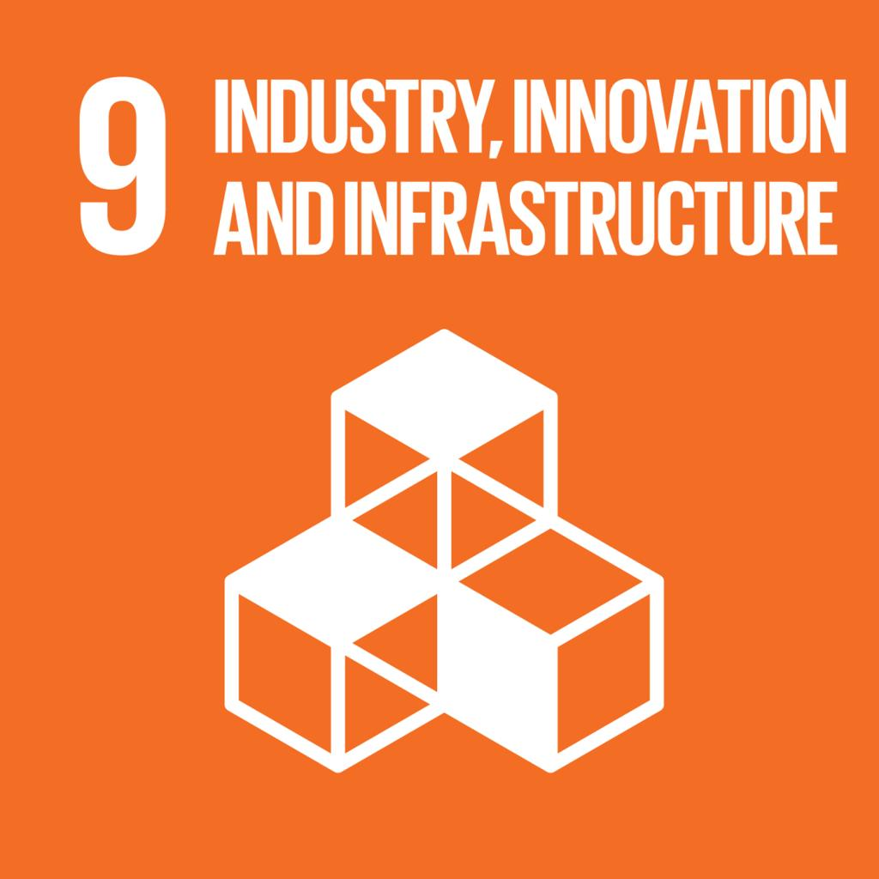


SDG Alignment:
🏗️ SDG 9: Industry, Innovation and Infrastructure
Target 9.1 — Develop reliable, sustainable and resilient infrastructure.
ThermalPulse uses satellite-assisted thermal screening, AI-supported image analysis, and digital inspection tracking to help identify bridges that may require closer inspection.
Our contribution: Support proactive bridge maintenance and infrastructure resilience through technology.
🏙️ SDG 11: Sustainable Cities and Communities
Target 11.2 — Accessible, safe, affordable and sustainable transport systems.
By helping authorities prioritize bridge inspections and coordinate maintenance, ThermalPulse aims to support more reliable transportation infrastructure for commuters and local communities.
🌱 SDG 13: Climate Action
Target 13.1 — Strengthen resilience and adaptive capacity to climate-related hazards.
ThermalPulse could support infrastructure monitoring by helping engineers investigate potential concerns associated with environmental exposure. Further validation is needed to demonstrate its effectiveness in climate-related risk assessment.

Slide 5
Existing Solution:
🌉 Several technologies are already used to monitor bridge conditions and identify potential structural defects. However, each method has its own limitations in coverage, cost, accessibility, or workflow integration.
🏗️ 1. Existing solutions and their limitations
👷 Manual Bridge Inspection
Engineers visually examine bridge components and assess visible defects.
⚠️ Limitation: Requires trained personnel, physical access, and considerable inspection time.
🚁 Drone-Based Inspection
Cameras capture images of bridge surfaces and difficult-to-reach areas.
⚠️ Limitation: Image coverage can be incomplete, and physical examination may still be necessary.
📡 Structural Health Monitoring (SHM)
Sensors measure parameters such as vibration, strain, and structural movement.
⚠️ Limitation: Sensor installation, maintenance, and data interpretation can require specialized resources.
Existing bridge inspection solutions include manual inspections, drone-based imaging, structural health monitoring sensors, and AI-based defect detection. Although these methods provide valuable information, they can have limitations in accessibility, coverage, data integration, and maintenance coordination.
ThermalPulse proposes an integrated platform that combines satellite-assisted thermal screening, AI-supported ground-image analysis, geospatial visualization, and repair tracking. Its key innovation is connecting potential defect identification with inspection prioritization and documented repair verification in a unified workflow.

Slide 6
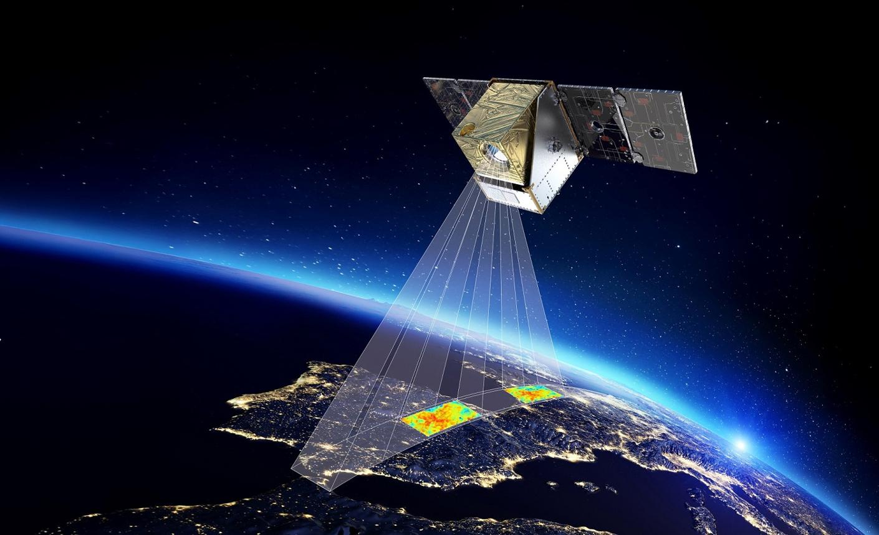
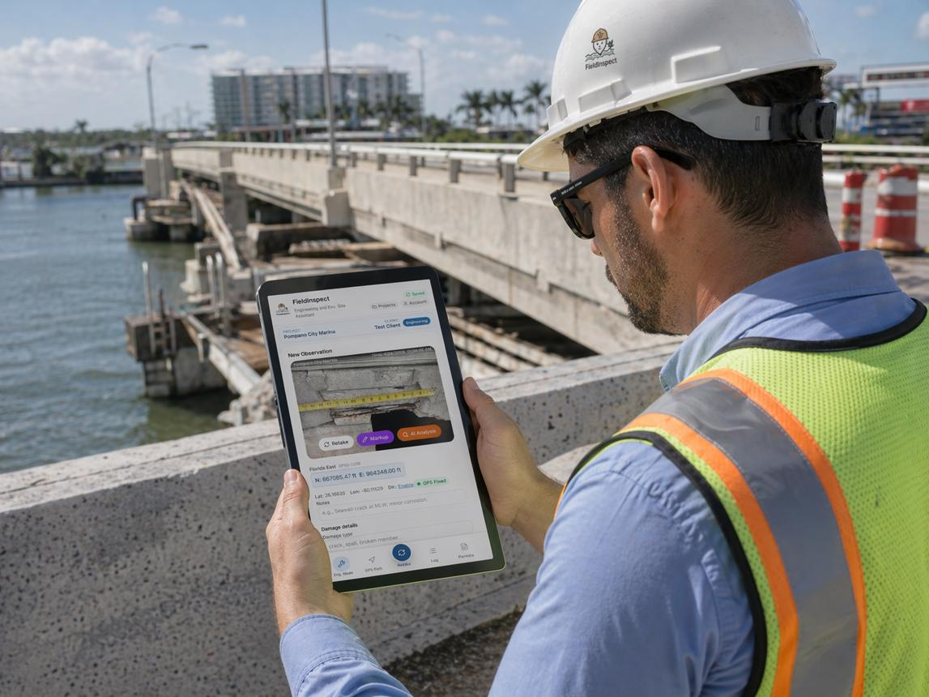
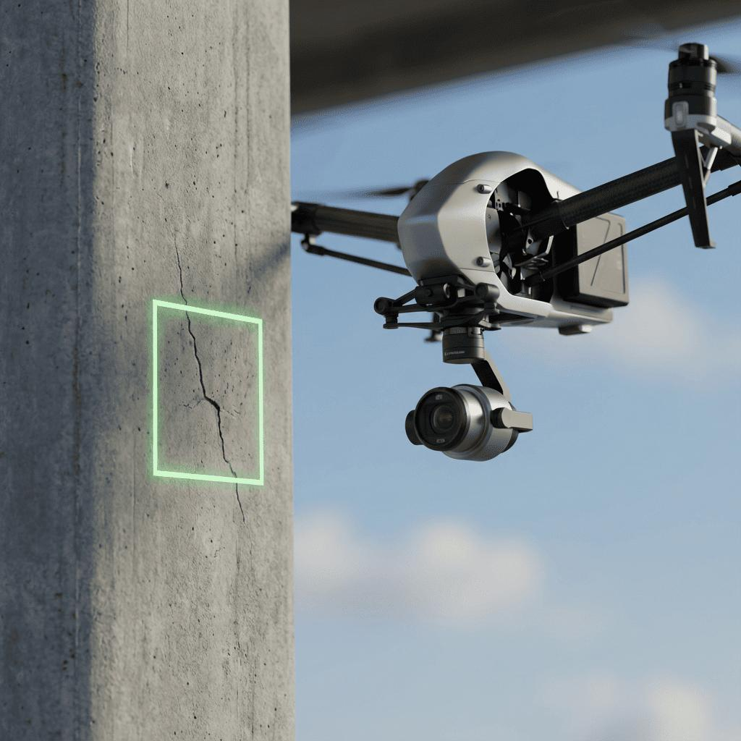
Proposed Solution:
ThermalPulse: Space-Driven Infrastructure Health and Automated Bridge Auditor
ThermalPulse is an AI-assisted bridge-monitoring platform designed to help identify potential infrastructure concerns, prioritize inspections, and manage maintenance activities through a centralized web dashboard.
🛰️ 1. Satellite-Based Thermal Screening
Use satellite-derived surface-temperature data to flag unusual thermal patterns around bridges for further investigation.
🤖 2. AI-Powered Image Analysis
Analyze ground-level bridge photographs to help identify visible defects, such as cracks and concrete surface damage, for professional review.
🗺️ 3. Smart Monitoring Dashboard
Display bridge locations, observations, inspection history, priority levels, and maintenance updates in one centralized interface.
🚙 4. Autonomous Repair Vehicle Simulation
Demonstrate a simulated vehicle workflow that receives an approved maintenance task, travels to a designated site, and records the task status. Human authorization is required before repair actions.
✅ 5. Repair Verification and Notifications
Store post-repair photographs, update job status, and notify authorized reviewers when verification is pending or further inspection is required.

Slide 7
System workflow/Architecture:
ThermalPulse follows a structured workflow that transforms infrastructure data into actionable inspection and maintenance information. First, satellite-derived thermal data and ground-level bridge images are collected. The data is processed using geospatial techniques and AI-assisted image analysis to identify unusual thermal patterns and potential visible defects. The results are displayed on an interactive dashboard, where bridges can be prioritized for professional inspection. After an engineer reviews and authorizes the maintenance task, a simulated autonomous repair vehicle demonstrates the assigned task and updates its progress. Finally, post-repair evidence is recorded, verification status is updated, and notifications are generated for relevant users. The system uses a React-based frontend, a Python FastAPI backend, AI and geospatial processing modules, and a PostgreSQL/PostGIS database to support the workflow.

Slide 8
💻 Technology Stack:
ThermalPulse uses a modern combination of web development, artificial intelligence, and geospatial technologies to support intelligent bridge monitoring. React.js, TypeScript, and Tailwind CSS are used to develop a responsive and interactive user interface, while Python and FastAPI handle backend services and data processing. AI and Machine Learning libraries such as OpenCV and scikit-learn support image analysis and anomaly screening. Landsat satellite data, Rasterio, and GeoPandas enable thermal-data processing and geospatial analysis. React Leaflet and OpenStreetMap provide interactive bridge maps, while PostgreSQL with PostGIS or Supabase stores bridge details, inspection records, and maintenance information. Recharts visualizes inspection trends, and WebSocket communication can provide live dashboard updates. The prototype also includes a simulated autonomous repair vehicle to demonstrate task assignment, progress tracking, and repair verification.

Slide 9
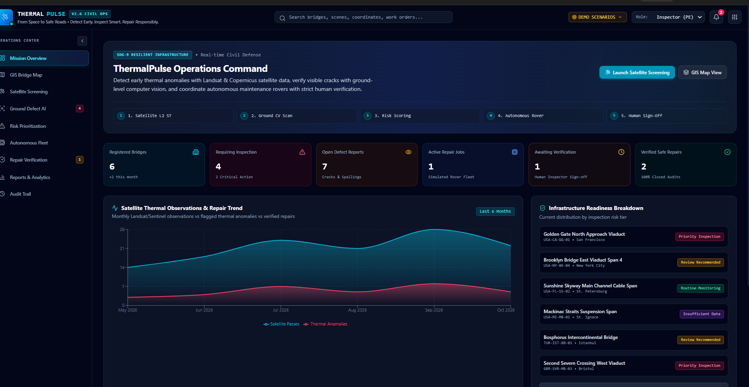
Prototype/Working demo:

Slide 10
Innovation/USP:
ThermalPulse introduces an integrated, AI-assisted approach to bridge infrastructure monitoring by combining satellite-derived thermal observations, ground-level image analysis, geospatial visualization, and maintenance tracking in a single platform.
🛰️ 1. Satellite-Assisted Early Screening: Uses satellite thermal data to flag unusual surface-temperature patterns that may require further investigation.
🤖 2. AI-Powered Visual Assessment: Analyzes ground-level bridge images to help identify visible defects and support inspection prioritization.
🗺️ 3. Unified Monitoring Dashboard: Combines bridge locations, inspection findings, risk indicators, maintenance records, and progress updates in one interface.
🚙 4. Autonomous Repair Workflow Simulation: Demonstrates how a repair vehicle could receive an authorized task and report its progress through a simulated workflow.
✅ 5. Closed-Loop Repair Verification: Connects inspection findings with repair records and post-repair evidence, allowing authorized reviewers to track whether a repair has been verified or requires further assessment.
🌟 Unique Selling Proposition (USP)
Unlike a standalone inspection or image-analysis tool, ThermalPulse aims to connect the entire infrastructure maintenance workflow—from satellite-assisted screening and AI-supported assessment to maintenance coordination and documented repair verification. Its key differentiator is the integration of geospatial intelligence, AI-assisted inspection, and accountable maintenance tracking within one platform.
🎯 Innovation Impact
ThermalPulse aims to support proactive inspection planning, improve maintenance visibility, reduce fragmented record-keeping, and contribute to more resilient infrastructure management in alignment with SDG 9.

Slide 11
Impact:
🌉 Social, Environmental and Technological Impact
ThermalPulse aims to improve bridge infrastructure monitoring through AI-assisted analysis, satellite-derived thermal observations, and digital maintenance management.
🛡️ 1. Public Safety: Helps authorities identify potential infrastructure concerns and prioritize bridges for professional inspection.
⏱️ 2. Time Efficiency: Supports faster review of inspection information and helps maintenance teams organize their work more effectively.
💰 3. Resource Optimization: Helps authorities prioritize inspection and maintenance resources based on documented observations and inspection needs.
🏙️ 4. Community Benefits: Supports more reliable transportation infrastructure for commuters, businesses, and local communities through proactive maintenance planning.
🌱 5. Environmental Resilience: Supports the monitoring of infrastructure exposed to environmental conditions and encourages evidence-based maintenance planning.
🤖 6. Technological Advancement: Demonstrates the integration of satellite data, AI-assisted image analysis, geospatial mapping, and simulated autonomous repair workflows.
📋 7. Improved Accountability: Maintains digital records of inspection findings, maintenance activities, and post-repair verification outcomes.
🎯 Long-Term Impact
ThermalPulse aims to support a shift from fragmented, reactive maintenance processes toward proactive, data-driven infrastructure management. By connecting screening, inspection prioritization, maintenance tracking, and repair verification, the platform contributes to the development of more reliable and resilient infrastructure in alignment with SDG 9, with supporting links to SDG 11 and SDG 13.

Slide 12
Feasability&Scalability:
ThermalPulse is feasible as a hackathon prototype using existing web development frameworks, open satellite datasets, AI libraries, and geospatial tools.
Technical Feasibility: React, Python FastAPI, OpenCV, and geospatial libraries can be used to develop the monitoring dashboard, analyze inspection images, and process satellite-derived thermal observations.
Economic Feasibility: Open-source software and publicly available satellite datasets can reduce initial development costs. Basic cloud hosting and database services can support the prototype.
Operational Feasibility: A centralized dashboard can help engineers review potential concerns, prioritize inspections, and manage maintenance records. The initial prototype can demonstrate the autonomous repair vehicle through simulation without requiring physical robotics hardware.
Implementation Feasibility: The system can be developed incrementally, beginning with sample bridge data and dashboard functions, followed by satellite-data processing, image analysis, maintenance tracking, and repair verification.
🚀 Scalability
Geographical Expansion: The platform can be extended from a small bridge demonstration to larger regional infrastructure networks by adding bridge records and geospatial datasets.
Multi-Source Integration: Future versions can incorporate additional satellite observations, drone imagery, ground inspection photographs, and structural sensor data.
Advanced AI Integration: Models can be improved using validated inspection datasets to support more reliable identification and prioritization of potential defects.
Cloud Deployment: Cloud infrastructure and scalable database services can support multiple users, larger datasets, and access across different locations.
Institutional Adoption: The platform could be adapted for municipal corporations, highway authorities, infrastructure maintenance agencies, and engineering inspection teams.
🎯 Future Growth
ThermalPulse can evolve from a demonstration platform into a field-tested infrastructure monitoring system through pilot projects, engineering validation, integration with existing maintenance systems, and carefully controlled automation. Real-world deployment would require reliable data, cybersecurity, professional oversight, and appropriate safety validation.

Slide 13
Future Scope & References:
ThermalPulse can be further developed into a comprehensive infrastructure monitoring platform through the following enhancements:
1. Real-Time and Multi-Source Monitoring: Integrate satellite imagery, drone photographs, and ground-level inspection data to improve bridge monitoring coverage.
2. Advanced AI Models: Develop and validate computer vision models using verified bridge inspection images to improve the identification of visible defects.
3. IoT Sensor Integration: Incorporate structural sensors that measure vibration, strain, and movement to provide additional information for engineering assessment.
4. Autonomous Inspection and Repair Robotics: Extend the simulated vehicle into a physical robotic platform for controlled inspection and, in the future, validated repair tasks.
5. Cloud-Based Deployment: Scale the application to support multiple bridges, regions, engineering teams, and infrastructure authorities.
6. Predictive Maintenance and Alerts: Develop data-driven maintenance forecasting and notifications to help authorities plan inspections and allocate resources efficiently.
7. Improved Repair Verification: Introduce standardized post-repair image capture, engineer approval, and digital maintenance records to track repair outcomes.
References
1. Federal Highway Administration (FHWA) — National Bridge Inventory and Bridge Condition Data. https://www.fhwa.dot.gov/bridge/britab.cfm
2. United States Geological Survey (USGS) — Landsat Collection 2 Surface Temperature. https://www.usgs.gov/landsat-missions/landsat-collection-2-surface-temperature
3. Luo et al. (2023) — Computer Vision-Based Bridge Inspection and Monitoring: A Review. Sensors, 23(18), 7863. https://doi.org/10.3390/s23187863
4. United Nations — Sustainable Development Goal 9: Industry, Innovation and Infrastructure. https://sdgs.un.org/goals/goal9
5. OpenStreetMap — Collaborative Mapping Project. https://www.openstreetmap.org/
6. FastAPI Documentation — Python Framework for Building APIs. https://fastapi.tiangolo.com/

Slide 14
THANK YOU

